Slide 1
Utilizing Learning Targets and Formative Assessments with English Learners
Dr. Kimberly Moreno, Ed.D
Passaic Academy for Science and Engineering

Slide 2
What are learning targets?
Do now:
Turn to your partner and write three things that you know about learning targets and develop one wonder about learning targets.
*Share out whole group*

Slide 3
Learning Targets and Success Criteria:
Learning target:
I can write/share learning targets & success criteria.
Success Criteria:
I can explain 3 differences between learning targets and instructional objectives.
I can write my own learning target and success criteria.
I know formative assessment is ongoing throughout the lesson.
I know 2 strategies that I can use for formative assessment in my classroom.

Slide 4
“Students who can identify what they are learning significantly outscore those who cannot.”
Robert J. Marzano

Slide 5
Researched Based Strategies
5 Research-based strategies that significantly improve student learning:
  Clarifying and sharing learning intentions and criteria for success
  Effective Questioning
  Descriptive Feedback that moves learners forward
  Peer assessment
  Self-assessment
Notes:
(Engineering effective discussion, questions, activities, and tasks that elicit evidence of learning)
(Students as instructional resources for one another.)
(Activating students as owners of their own learning.)

Slide 6



Instructional Objectives and
Learning Targets Comparison
Use the link below to share your responses:
https://tinyurl.com/LoLtcomparison
Notes:
https://tinyurl.com/LoLtcomparison
This illustrates what happens when a teacher relies on teacher-centered instructional objectives to guide planning.
The teacher is the only one in the classroom who knows where the lesson is headed and expends a great deal of energy trying to get students to meet the instructional objective.
●It refers to the student in the third person
●Students usually don’t understand what the sentence means (adult language)
●They haven’t studies the concepts yet
In contrast, learning targets help teachers and students form a learning partnership in the classroom.
Both halves of the classroom learning team know exactly what they are aiming for in today’s lesson – what students will come to know and understand, how well they will know it, and how they will provide evidence that they know it.
Student’s point of view (student friendly language)

Slide 7
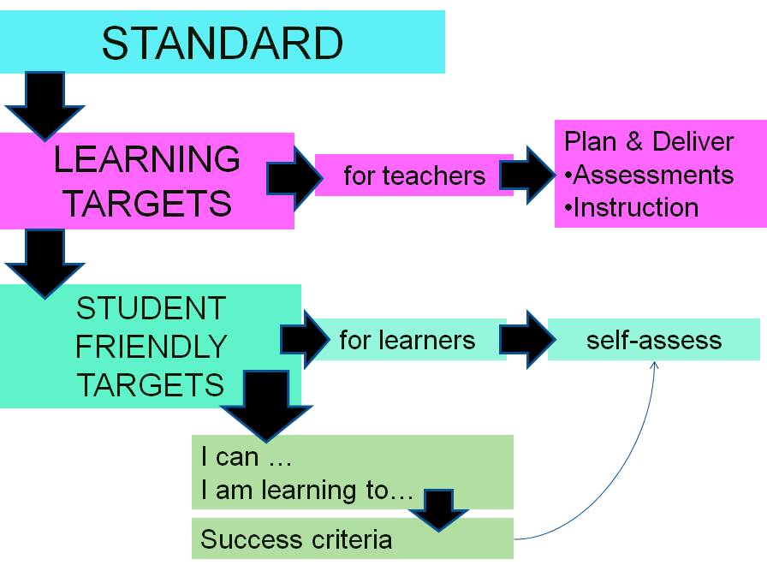
OBJECTIVE

Slide 8

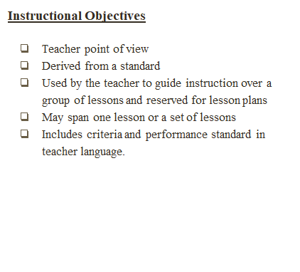


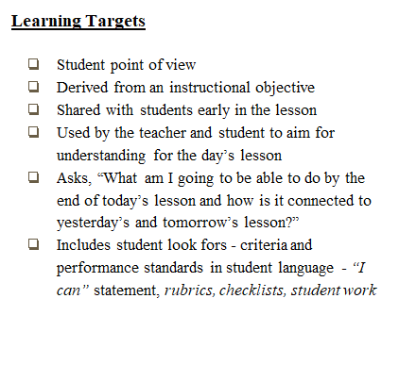

Notes:
Discussion (5 mins):
Teacher/Student benefits *Post-Its*
Teacher benefits:
WHAT to assess – instructional guide – keep focused.
CLARITY in planning – look for instructional activities & strategies to help all students reach that specific target.
Better BALANCE of “in depth” study vs. “just covering the material.”
Know what your assessments REFLECT at a finer grain.
Help to MAXIMIZE student achievement.
OPPORTUNITY to work collaboratively with other teaching professionals.
Student Benefits:
Able focus on the aspect at hand and not get distracted by other things.
Able to look at the posted target to remind themselves of what they are supposed to be doing.

Slide 9

ELA Example Grade 3
Instructional Objective:
Students will learn how to analyze a text to determine, and be able to summarize, the main idea of a text.
Teacher Criteria/Assessment (Content Outcome)
  Student can say, select, or write the main idea of a passage with accuracy.
Learning Target: (Communicated to the Students)
I will learn how to identify the main idea of a paragraph.
Student Criteria/Assessment (Look-fors)
  As I read, I ask myself what the text is mostly about.
  To figure out the main idea, I see if there is a pop-out sentence that shows it.
  I can say the main idea in more than just a word .
  I can also choose important supporting details that go with the main idea.
  I summarize briefly, leaving out unimportant things

Slide 10
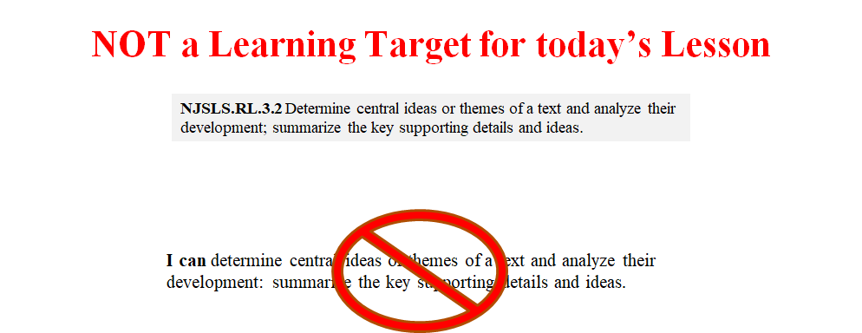
Notes:
This is not one lesson-sized chunk, and it is mostly in teacher language, just with an “I can” stuck on at the beginning

Slide 11
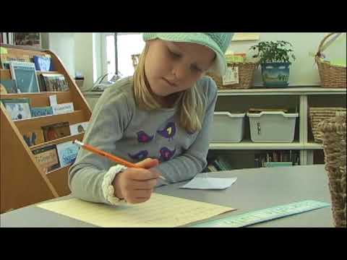
Using a Learning Target Throughout a Lesson
Notes:
https://www.youtube.com/watch?v=v3wAQjzuOAw

Slide 12
Task

Slide 13
Unpack a Standard
&
Write Learning Targets
What are the standards asking students to: ✔ know? ✔ understand? ✔ be able to do?
What do the verbs indicate students should be expected to be able to do– identify, understand, infer, analyze, apply? What level of thinking is required? Webb’s DOK or Bloom’s Taxonomy or Marzano’s Taxonomy?
What will be our evidence that the students have achieved the learning goal? How will we know if they know it?

Slide 14
How to check for understanding?
(aka formative assessment)

Slide 15

How are we currently assessing the learning of each lesson?
Notes:
Placement of the DOL
Summative in nature
Asks student to do more of the same
Teacher generated
Hinders ongoing formative assessments

Slide 16
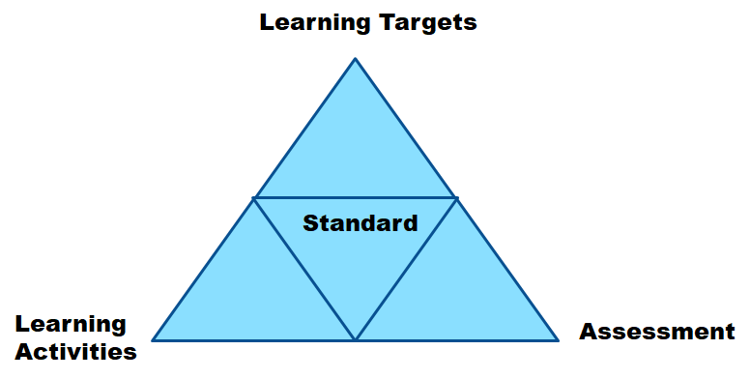
“Magic Triangle”
Notes:
This triangle represents the relationship
between learning targets, assessments and learning activities.
If these three components are congruent,
…they achieve an exact match with the Standard,
then teaching and learning is enhanced.

Slide 17
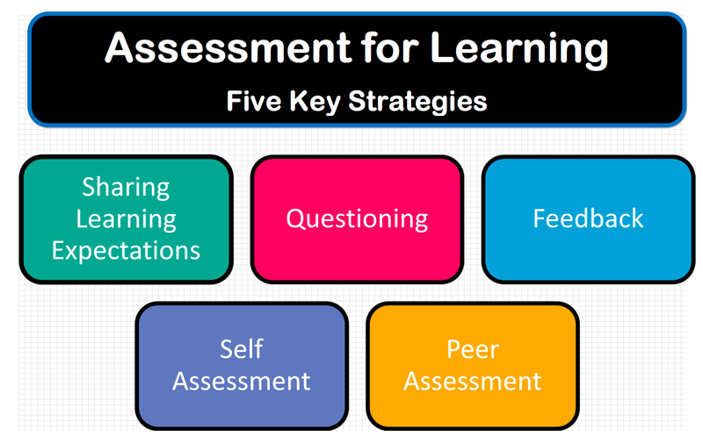
Notes:
a wide variety of methods that teachers use to conduct in-process evaluations of student comprehension, learning needs, and academic progress during a lesson, unit, or course

Slide 18

Formative Assessment Strategies
Traffic Light
•Place a green dot on the left side of the sheet for any goals that you feel you have already mastered.
•Place a yellow dot on the left side of the sheet for any goals that you know something about but have not yet mastered.
•Place a red dot on the left side of the sheet for any goals that you have either never heard of or that you know virtually nothing about.

Slide 19
Formative Assessment Strategies
Formative Feedback
Provide Effective Feedback
The best feedback is:
Descriptive
Specific
Relevant
Timely
Empowering

Slide 20
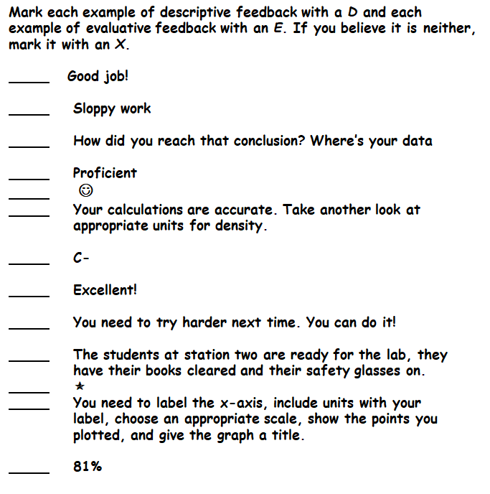
Notes:
E, E, D, E, E,D, E, E, E, D, E, X, E/D

Slide 21
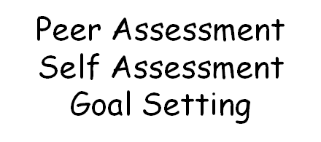

Formative Assessment Strategies
Involve Students

Slide 22
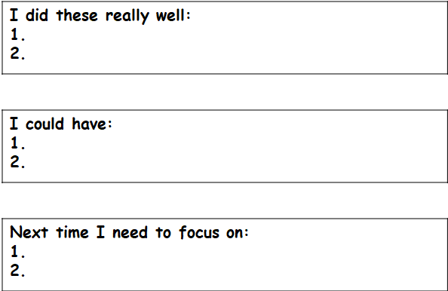
Self Assessment or Peer Assessment Task

Slide 23
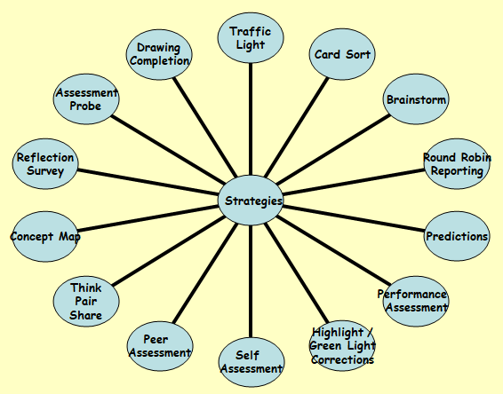
Notes:
•Clarify your purpose.
•Define your target goals.
•Design your plan - what tool(s) will I use to determine if students have met the goals?
•Provide feedback to encourage learning (Do No Harm!)
•Involve students in their own assessment.

Slide 24
Learning Targets and Success Criteria:
Learning target:
I can write/share learning targets & success criteria.
Success Criteria:
I can explain 3 differences between learning targets and instructional objectives.
I can write my own learning target and success criteria.
I know formative assessment is ongoing throughout the lesson.
I know 2 strategies that I can use for formative assessment in my classroom.

Slide 25
Any Questions?
kmoreno@passaicschools.org
kimberly.moreno1984@gmail.com

Slide 26

EXIT TICKET
Pretend your colleague was absent from this workshop today…
Write what you would say if you had to explain learning targets to your friend.

Slide 27
Resources & References:
http://www.ascd.org/ASCD/pdf/siteASCD/publications/books/learning-targets-sample-chapters.pdf
http://www.ascd.org/publications/educational-leadership/nov05/vol63/num03/Classroom-Assessment@-Minute-by-Minute,-Day-by-Day.aspx
Black, P.J., & Wiliam, D. (1998a). Assessment and classroom learning. Assessment in Education, 5(1), 7-73.
Black, P.J., & Wiliam, D. (1998b). Inside the black box: Raising standards through classroom assessment. London, UK: King’s College London School of Education.
Fisher, D., Grant, M., Frey, N., & Johnson, C. (2008). Taking formative assessment schoolwide. Educational Leadership, 65(4), 64-68.
Hattie, J., & Timperley, H. (2007). The power of feedback. Review of Educational Research, 77(1), 81-112. http://dx.doi.org/10.3102/003465430298487
Heritage, M. (2011). Formative assessment: An enabler of learning. Better: Evidence- based Education, 18–19. Baltimore, MD: Johns Hopkins University. Retrieved from http://www.bestevidence.org

